Slide 1
Rhetoric
the art of using
language to persuade

Slide 2
Guiding Questions :
What is meant by rhetorical appeal?
How can an author use
ethos, logos, and pathos
to shape and strengthen his argument?

Slide 3
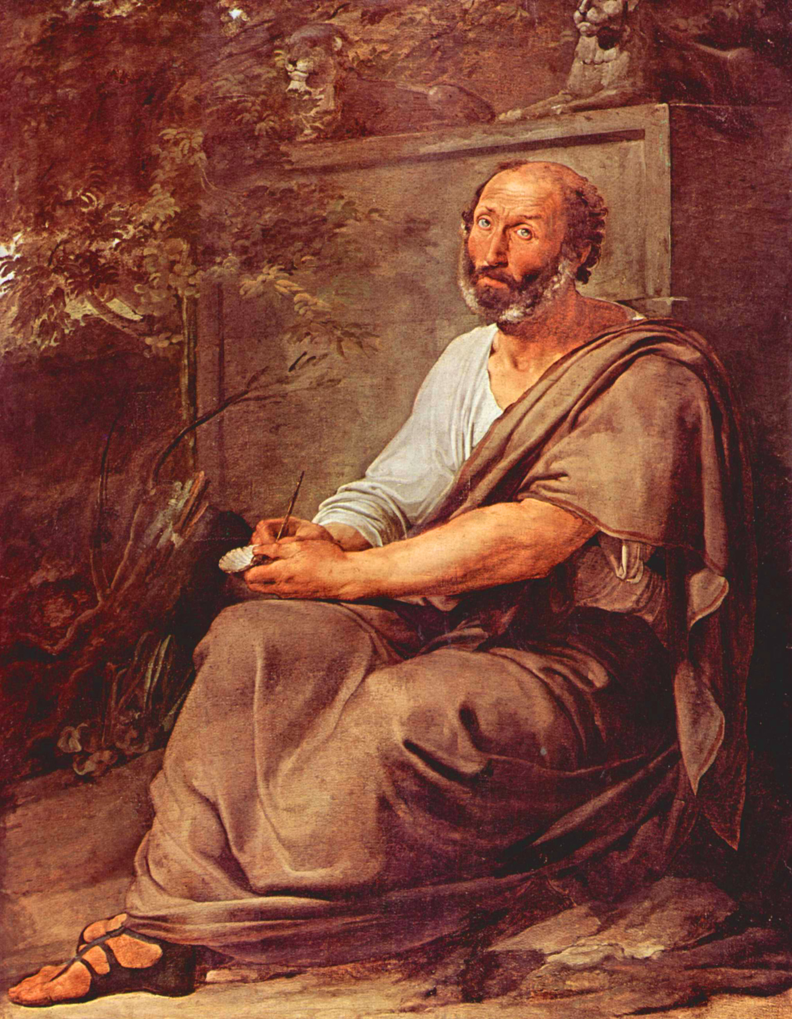
Aristotle Greek Philosopher, 4th Century BC
Who’s to blame?

Slide 4
Aristotle Greek Philosopher, 4th Century BC
There are
3 modes
of persuasion

Slide 5
1. Ethos 2. Logos 3. Pathos

Slide 6
1. Ethos
relates to a speaker or writer’s
character, credibility, or identity

Slide 7
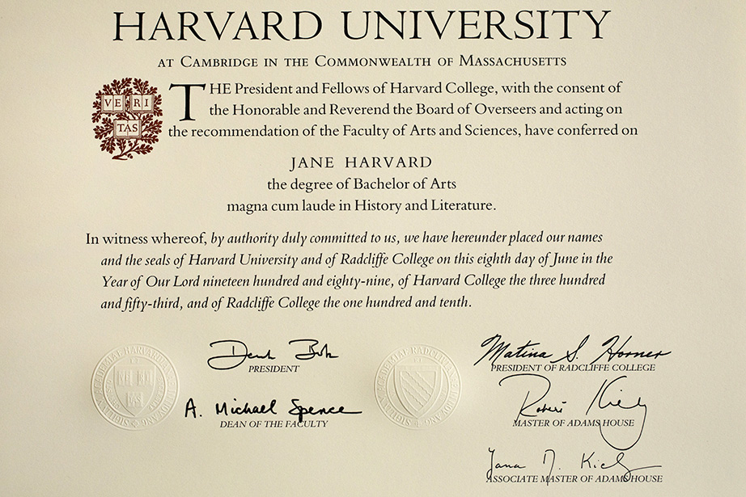
How to recognize Ethos
Credentials

Slide 8
How to recognize Ethos
Relevant personal experience
“I have done research and worked in this field for 20 years.”

Slide 9
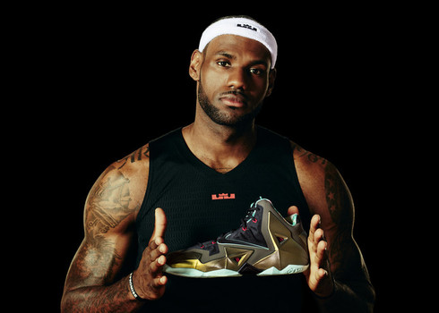
How to recognize Ethos
Testimonials
“4 out of 5 dentists use Crest.”

Slide 10
How to recognize Ethos
Sense of Identity
“Americans do not tolerate
injustice.”

Slide 11
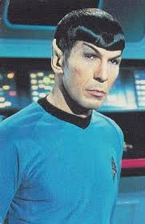
2. Logos
a speaker or writer’s
appeal to logic

Slide 12
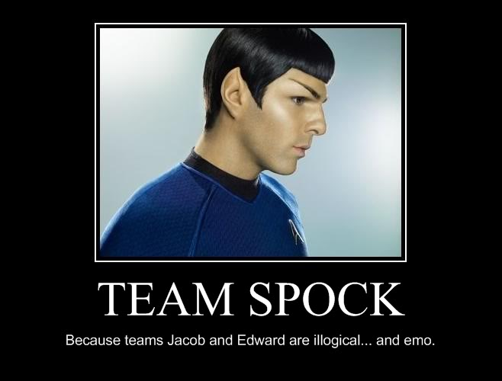

Slide 13
How to recognize Logos
If-then statements
“If you study regularly, then you will score higher on the test than if you just cram the night before.”

Slide 14
How to recognize Logos
Statistics
“Students who studied without their phones nearby scored 30% higher than those who had their phones nearby.”

Slide 15
How to recognize Logos
Anecdotes
“One time I tried to pull an all- nighter to study, but I fell asleep during the exam the next day.”

Slide 16
How to recognize Logos
Historical Examples
“Students from 30 years ago, who did not have the distractions of social media and video games, were able to focus for longer periods of time.”

Slide 17
How to recognize Logos
Concessions
(or anticipate the counter-point)
“While you may be thinking that things have changed since this study, according to recent research, the surprising truth is that…”

Slide 18
How to recognize Logos
Rhetorical Questions
“How are you supposed to retain academic information with the your favorite TV show playing and with your phone dinging with text messages?”

Slide 19
3. Pathos
a speaker or writer’s
appeal to emotions

Slide 20
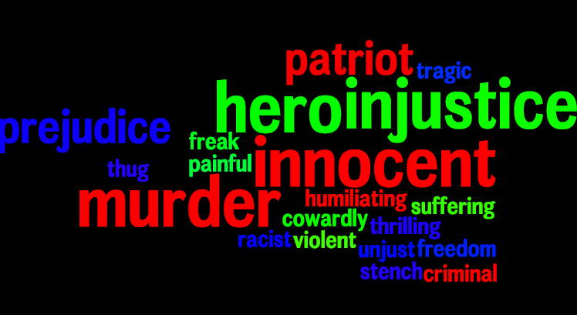
How to recognize Pathos
Emotive Words

Slide 21
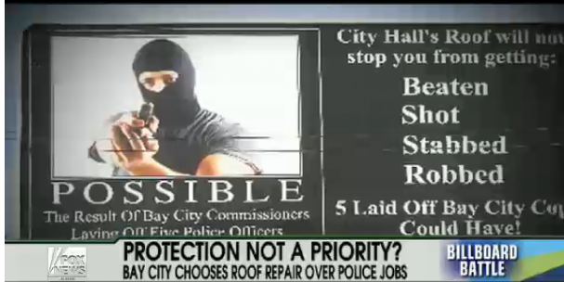
How to recognize Pathos
Fear

Slide 22
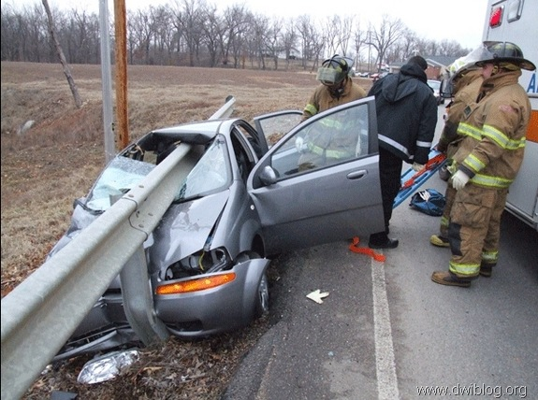
How to recognize Pathos
Consequences
Don’t
Drink
&
Drive

Slide 23
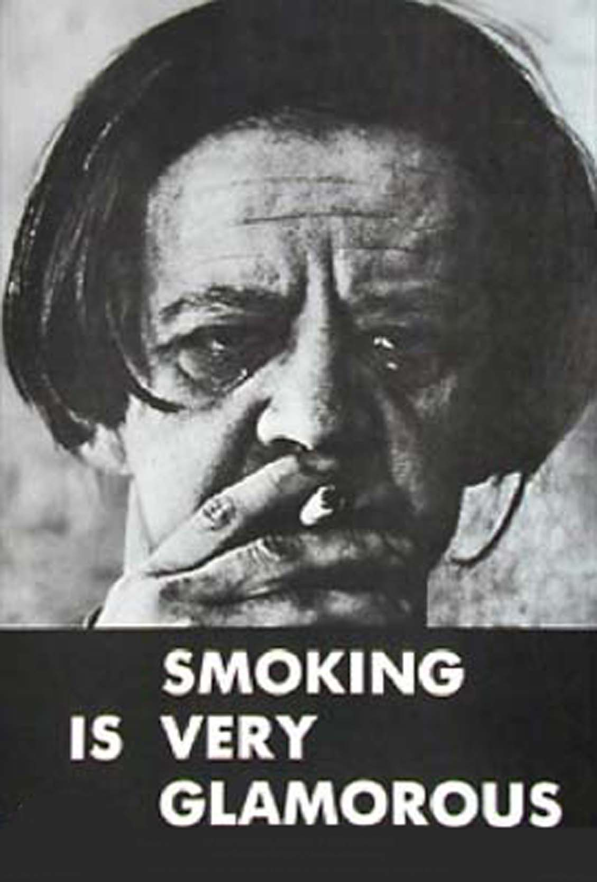
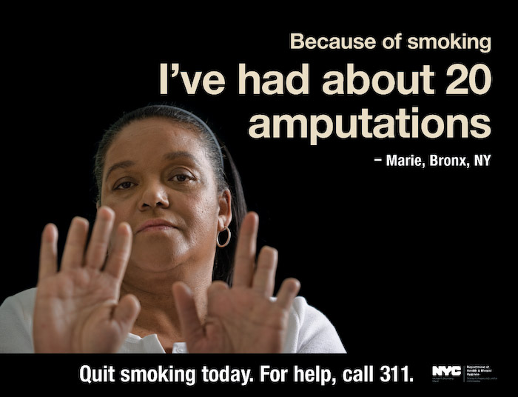
How to recognize Pathos
Consequences

Slide 24
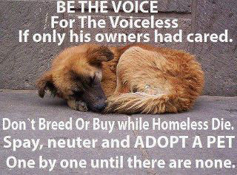
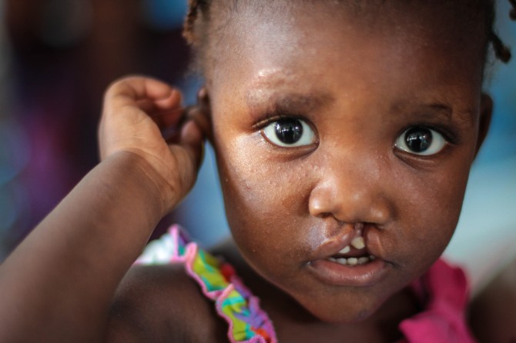
How to recognize Pathos
Pity

Slide 25
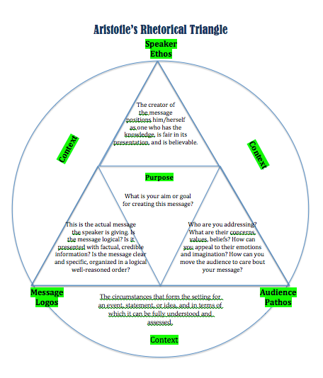

Slide 26
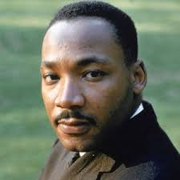
How does King use a balance of ethos, logos, and pathos
in his response to clergymen who called his Birmingham march “unwise and untimely”?

